Slide 1
Machine learning
in Epidemiological Models
ehsan.karim@ubc.ca
Oct 21, 2020
SPPH 504/007

Slide 2
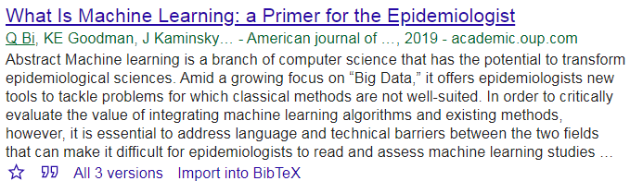
Ref
Reference for reading

Slide 3
Types of Epidemiological models
Y ~ A + C
Cardiovascular disease (CVD) ~ smoking +
Age + diet + obesity + cholesterol levels +
family history of heart disease

Slide 4
Types of Epidemiological models
Predictive models
  Predicting a health outcome,
  e.g., cardiovascular diseases (CDV)
Causal or explanatory models
  Relationship between two health components
  e.g., association between cardiovascular diseases (CDV) and smoking (smoking)

Slide 5
Analyzing Epidemiological Study data
Historically
Statistical techniques
  Logistic regression
  Parametric regression (more restrictive)
Big data era
Large datasets available
  Large number of variables / observation
  Conventional statistical techniques struggle

Slide 6
Machine learning (ML)
Followings are examples of machine learning?
Stepwise regression
  Uses AIC as a criterion
LASSO
  Uses cross validation to select parameters
Answer differs depending on who you ask.

Slide 7
Oversimplified definition of ML
General characteristics:
Prioritizes predictive accuracy
Less focus on inference/hypothesis testing
Handles big-data
  Large number of observations?
  Large number of covariates?
What about causal models?

Slide 8
Terminologies - I
Outcome variable: CDV
  Output
Possible values of outcome: CVD vs. no CVD
  Label
Rare outcome: CVD rare
  Imbalanced data
Outcome group with highest frequency
  Majority class
Outcome group with lowest frequency
  Minority class
  Dependent variable
  Predicted variable

Slide 9
Terminologies - II
Independent variables / covariates:
  Attribute
  Feature
  Predictor
  Field
Exposure variable: smoking
  Input
# of covariates
  Dimensionality
age, diet, obesity, cholesterol levels. family history of heart disease
  Explanatory variable
  Predictor variable

Slide 10
Terminologies - III
Model: Logistic regression
  Classifier
  Estimator
Model fitting algorithm: stepwise based on AIC
  Learner
Domain
  Range of possible values
Error measure: MSE
  Loss function

Slide 11
Classification of ML
Supervised learning
  Values of outcome (label) are known
    Logistic regression
X = age, obesity levels, cholesterol levels
New subject from 2020,
X data
Risk of a cardiovascular event
Build model
Y = experienced a cardiovascular event or not
2019

Slide 12
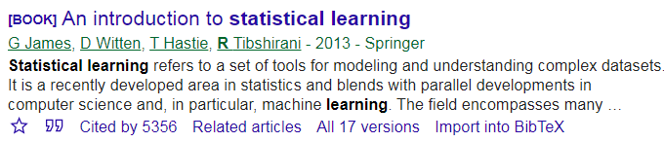
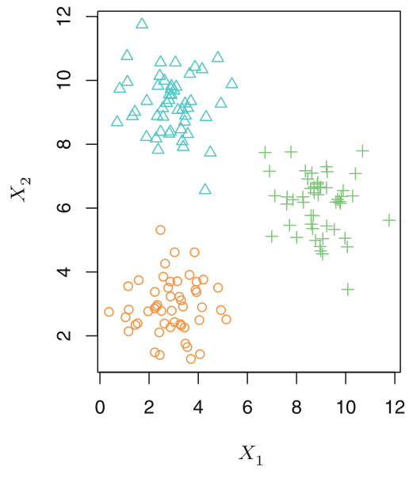
Classification of ML
Supervised learning
  Values of outcome (label) are known
    Logistic regression
unsupervised learning
  Values of outcome (label) are unknown, needs to be discovered
    Clustering
      Without being an expert, grouping data
Semi-supervised learning
  In between
  a training dataset
    with both labeled and unlabeled data
    Medical imaging is a great application
A clustering data set involving 3 groups

Slide 13
Classification of Supervised learning
Classification
  Prediction of categorical outcomes
  Logistic regression
Regression
  Prediction of continuous outcomes
  Linear regression

Slide 14
Other classifications
Generative
  Computes the conditional probability indirectly via joint probability
  Models P(X,Y) first
  then decomposes as P(Y|X) = P(X,Y)/P(X)
    Hidden markov model / naive bayes
Discriminative [epidemiologists mostly use this]
  Models the conditional probability
  P(Y|X)
    Logistic / linear regression
Reinforced learning
  Self-adaptive, learns gradually/iteratively to improve performance

Slide 15
Popular ML algorithms
Decision tree
  Regression and classification trees
Shrinkage methods
  lasso
Ensemble methods
  Super learner

Slide 16
ML algorithm I: Decision tree
Decision tree
  A flow-chart like structure
  A decision support tool
  Referred to as CART
    Classification and regression trees
    Covers
      Classification (categorical outcome)
      Regression (continuous outcome)
  Easy to understand
  Flexible to incorporate non-linear effects automatically
    No need to specify higher order terms / interactions
  Unstable, prone to overfitting, suffers from high variance

Slide 17
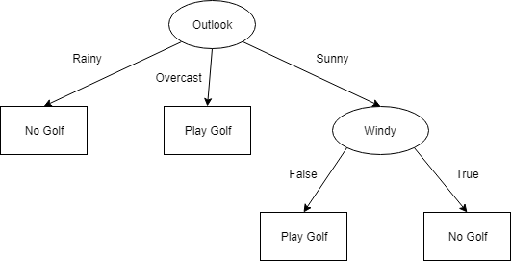
ML algorithm I: Decision tree
Ref: https://towardsdatascience.com/light-on-math-machine-learning-intuitive-guide-to-understanding-decision-trees-adb2165ccab7

Slide 18
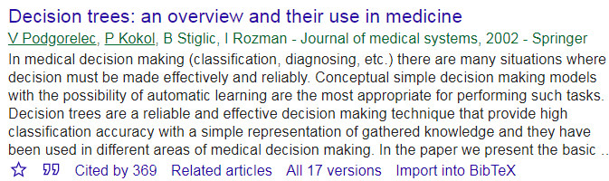
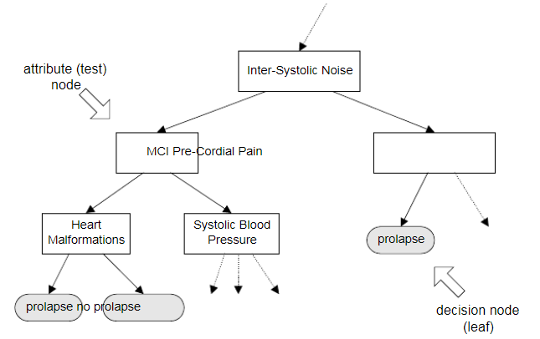
ML algorithm I: Decision tree
Terminologies
  Root node
  Splitting
    Minimize Residual SS
  Brunch
  Sub-node
    decision node / attribute
  Terminal node/leaf
  Prunning
    reduces the size of decision trees by removing not so useful sections/nodes
Root node
Splitting based on splitting rule
Brunch/section
decision-node
Terminal node

Slide 19
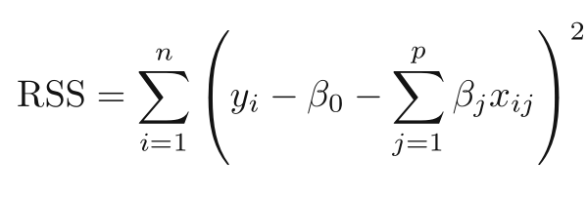
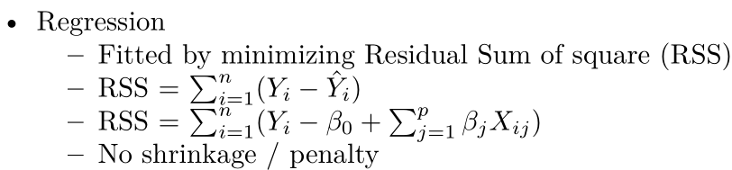

ML algorithm 2: Shrinkage Methods
Regression (no shrinkage)
  Minimize Residual SS

Slide 20
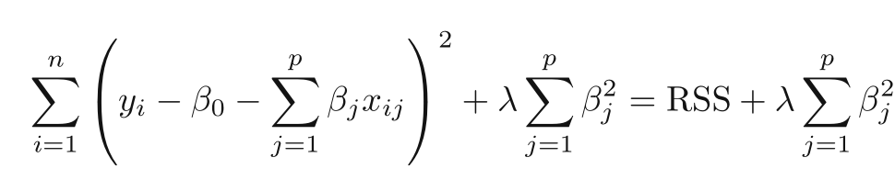
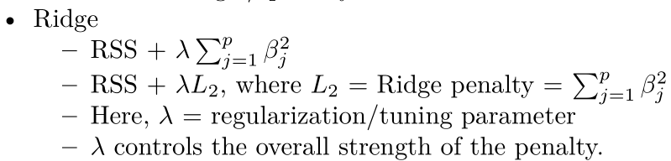
ML algorithm 2: Shrinkage Methods
Ridge
  All coef = non-zero
How to estimate lambda?
  Cross validation to minimize error (e.g., RMSE).

Slide 21
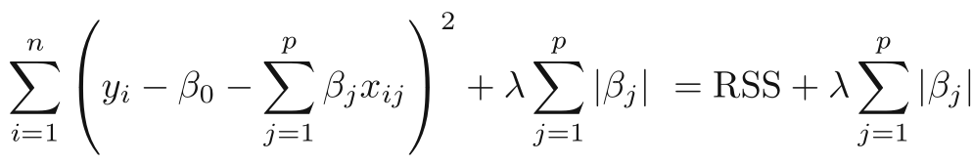
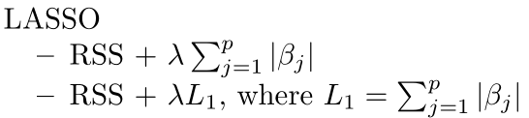
ML algorithm 2: Shrinkage Methods
LASSO
  Assigns some coef = 0
  Can be unstable
  Addresses collinearity

Slide 22
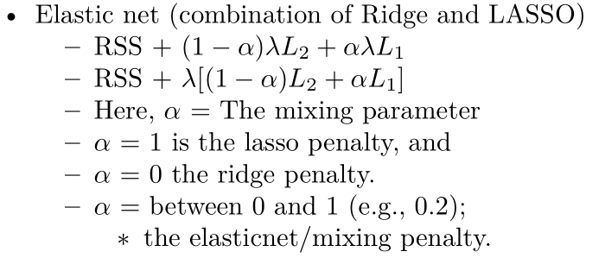
ML algorithm 2: Shrinkage Methods
Elastic net
  Compromise (2 parameters): Alpha and lambda

Slide 23
ML algorithm 2: Shrinkage Methods
Regression (no shrinkage)
  Minimize Residual SS
Ridge
  All coef = non-zero
LASSO
  Assigns some coef = 0
  Can be unstable
  Addresses collinearity
Elasticnet
  Compromise
How to estimate lambda? Cross validation.

Slide 24
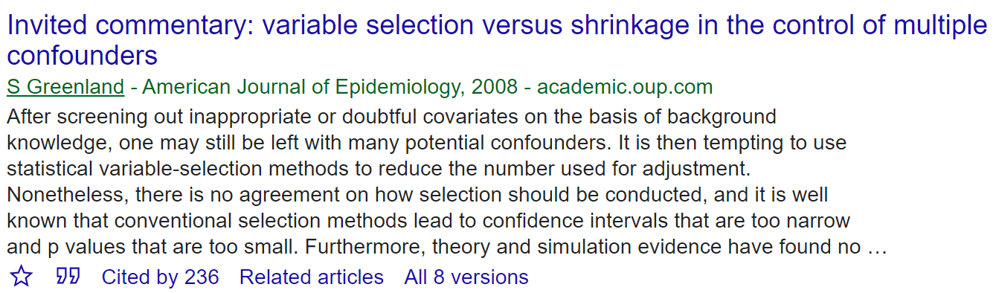
ML algorithm 2: Shrinkage Methods
Note: generally speaking:
  Not okay to select variables from a shrinkage model
  And then put those variables in non-shrinkage model
    A common issue in epidemiologic literature
  Shrinkage parameter determines predictions that is obtained via cross-validation

Slide 25
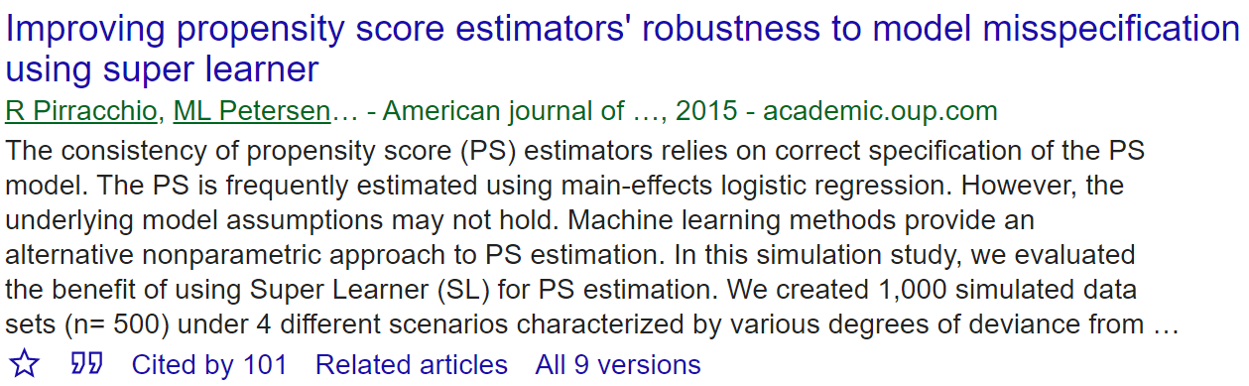
Ensemble methods
Uses information from multiple models to improve predictive performance compared to a single model.
Basic idea
  Individual models may not be adequate to capture the characteristics of the entire data
  We can build k models from k samples
  Once we combine these k models, we should get a better ‘full model’ in terms of predictive accuracy

Slide 26
Ensemble methods: Type - I
Training same model to different samples (of the same data)
  Bagging or bootstrap aggregation
    independent bootstrap samples (i = 1, 2, … B training sets),
    applies CART on each i (no prunning)
    Average the resulting predictions
    Reduces variance as a result of using bootstrap
  Boosting
    sequentially updated/weighted bootstrap based on previous learning
  Another variation could be “different models” in different samples
  Random forest
    Improvement over bagging
    Tweaks the algorithm so that predictions from all of the sub-nodes have less correlation

Slide 27
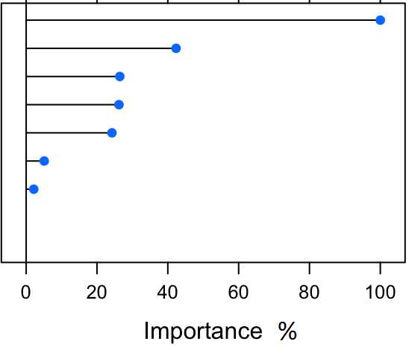
Ensemble methods: VIM
Variable Importance measure (VIM)
  bagging improves prediction accuracy
    over prediction using a single tree
  Looses interpretability
    as this is an average of many diagrams now
  But we can get a summary of the importance of each variable
    VIM_{i} = sum of the decrease in error when a variable i is used to split
    Relative VIM_{i} = VIM_{i}/max(VIM) so that VIMs are between 0 and 1
VIMs are also possible from
  random forest and
  boosting

Slide 28
Ensemble methods: Type - II
Training different models on the same data
  Bayesian model averaging (BMA) can use wide range of learners
  Super learner (SL)
    Large number of candidate learners (CL) with different strengths
      Parametric (logistic)
      Non-parametric (CART)
    Cross-validation: CL applied on training data, prediction made on test data
    Final prediction uses a weighted version of all predictions
      Weights = coef of Observed outcome ~ prediction from each CL

Slide 29
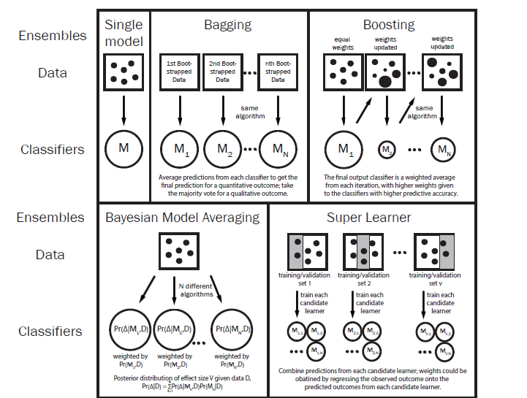
Ensemble methods: Types
Web-appendix
Differences

Slide 30
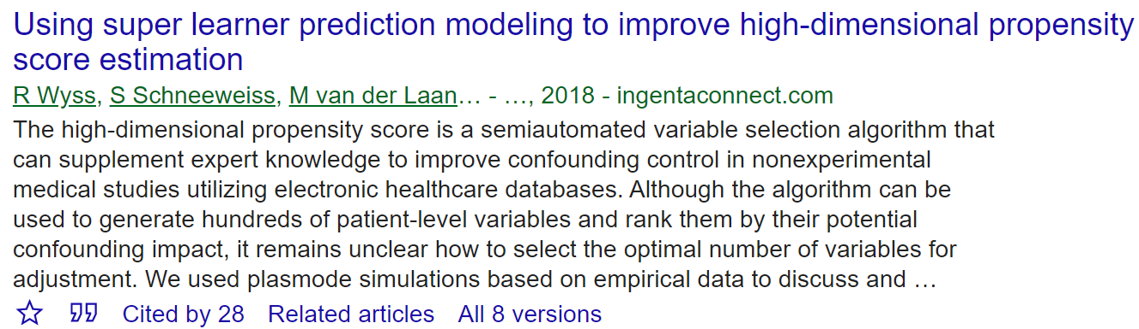
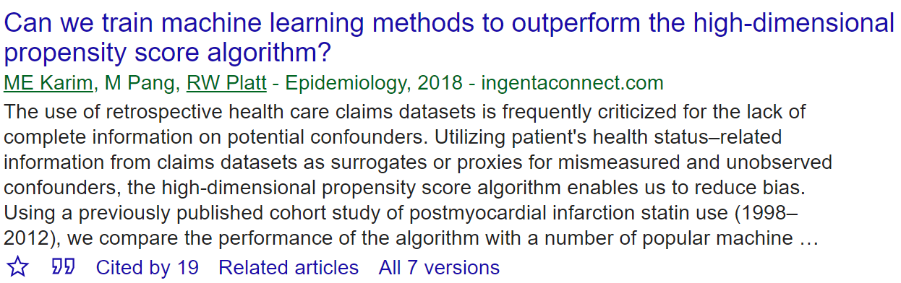
Epidemiologic applications
●Causal Modelling: CVD versus smoking
○Propensity score modelling
■Exposure modelling:
smoking ~ features
=> propensity score
■In Logistic regression we need to add
●interactions and non-linearities
■No need to specify them in CART methods
■Outcome modelling:
CVD ~ smoking + f(propensity score)

Slide 31
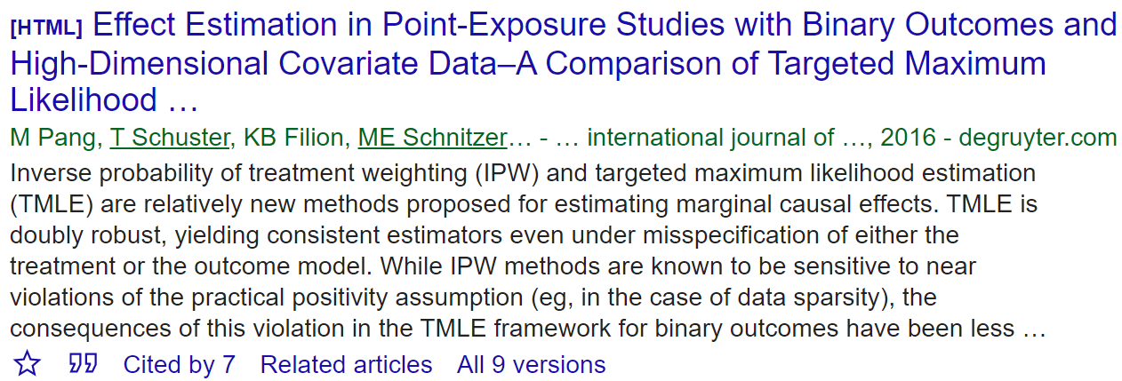
Epidemiologic applications
Causal inference: CVD versus smoking
  High-dimensional propensity score
    ML versions (LASSO) to add proxy variables
    Super learner (SL)
  Causal trees / causal forests
  Causal discovery to build DAGs automatically

Slide 32
Epidemiologic applications
Big data
  LASSO for dimension reduction
  ML on Gene expression data
    Many covariates compared to observations
  Forecasting infectious disease
  Propensity score modelling in the high dimensions
  Prognostic model building / risk score
    SL
  Geo-spatial data
  Text mining

Slide 33
Future Reading

Slide 34
Thanks!
ehsan.karim@ubc.ca
www.ehsank.com

